Slide 1

Marketing Analytics Project Car market prediction using Hierarchical Bayesian Logit Regression
MEMBERS: PARTH SHARMA, SPENCER BURKHART, NIKHAR JAIN

Slide 2
Table of Contents
Database: Choice-based survey data of cars - 224 respondents and 7 attributes (Brand, Engine, Audio, Seat trim, Safety, Warranty and Price)
Estimation Model: Hierarchical Multinomial Logit with Mixture-of-Normals Heterogeneity
K-means Clustering Analysis
Market Share Simulator
Relative Importance of attributes
Willingness to Pay

Slide 3
Hierarchical Multinomial Logit with Mixture - of - Normals Heterogeneity
2 levels of hierarchical bayes:
Higher level: Individuals’ parameters (betas or part worths) are described by a multivariate normal distribution.
Lower level: Given an individual’s betas, his/her probabilities of achieving some outcome (choosing products, or rating brands in a certain way) is governed by a particular model, such as multinomial logit or linear regression.
Notes:
Initial crude estimates of betas are estimated for each respondent to use as a starting point. New estimates are updated using an iterative process called “Gibbs Sampling.” The model estimates individual betas as well as the mean and covariances of the distribution of betas. In each iteration, an estimate is made for each parameter, conditional on current estimates of the others. This is done by making a random draw from each conditional distribution. Eventually, after many iterations, this process converges to correct estimates for each parameter. In other words, the HB algorithm produces betas that fit each individual’s outcome reasonably well, but “borrows” information from other respondents to stabilize the estimates.
HB permits estimation of individual-level models, which lets marketers more accurately target/model individuals. More specifically, HB permits estimation of models too demanding for traditional methods: even when estimating more beta coefficients per individual than there are individual observations. ! Aggregate estimation models confound heterogeneity and noise. By modeling individuals rather than the “average,” HB can separate signal (heterogeneity) from noise. This leads to more stable, accurate models whether viewed in terms of individual- or aggregate-level performance

Slide 4
Hierarchical Multinomial Logit with Mixture - of - Normals Heterogeneity
Benefits of hierarchical bayes:
HB permits estimation of individual-level models - more accurate targeting of individuals.
Leads to more stable, accurate models whether viewed in terms of individual- or aggregate-level performance.
Notes:
There are a number of diagnostic tools that you can use to check the convergence of the model. These include looking at the statistics of the parameter estimates themselves, checking trace plots which describe the evolution of the estimates throughout the iterations of the algorithm, and the posterior intervals which show the range of the sampled parameters.
Hierarchical Bayes uses a technique called Markov Chain Monte Carlo (MCMC) to estimate the parameters, which involves running a number of iterations where estimates of the parameters are generated at each iteration. This iterative sampling of parameters forms what is known as a Markov Chain.

Slide 5
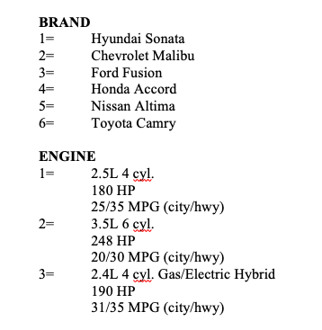
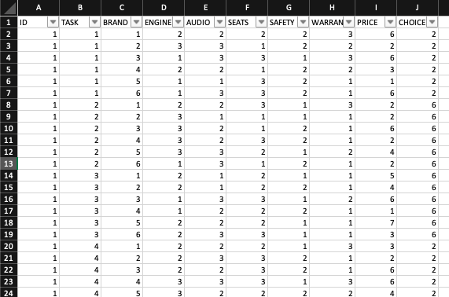
A look at the data set
Survey had 12 tasks with 7 choices

Slide 6
Data Preparation

Slide 7
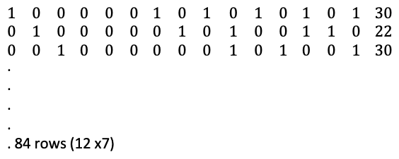
Data Preparation
dat ← list[ 1, 2, 3,........................................., 224]
$y = [2,3,1,6,3,3,7] #choice matrix
$X = #covariate matrix

Slide 8
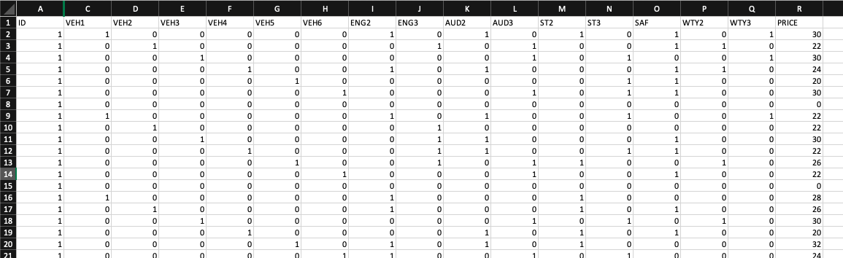
Data Preparation
$X- Covariate Matrix

Slide 9
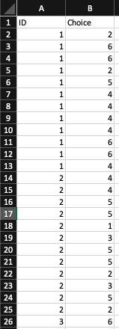
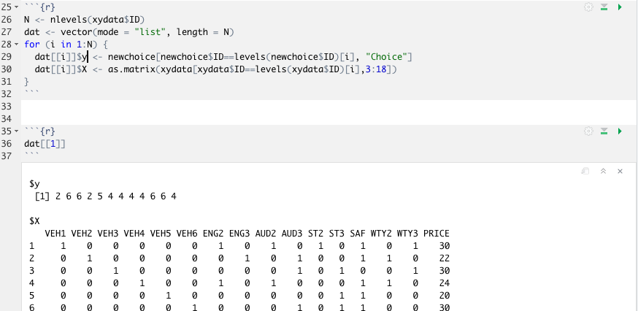
Data Preparation
$y- Choice Matrix

Slide 10
Model Estimation

Slide 11
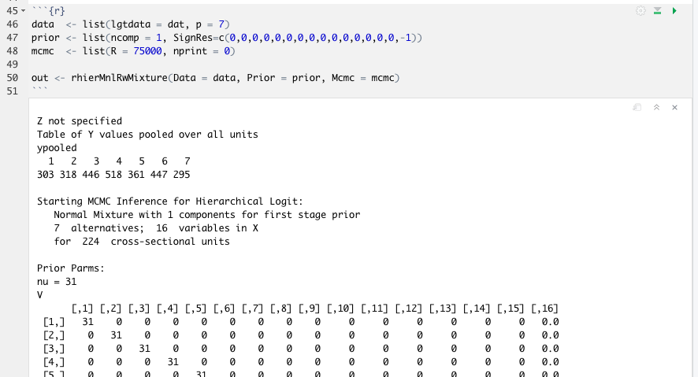
Model Estimation
Notes:
mcmc - markov chain monte carlo
prior- Model specific information. Sign res makes price coefficient negative

Slide 12
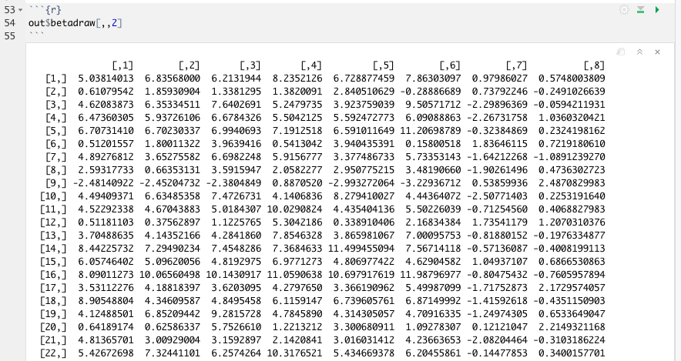

Slide 13
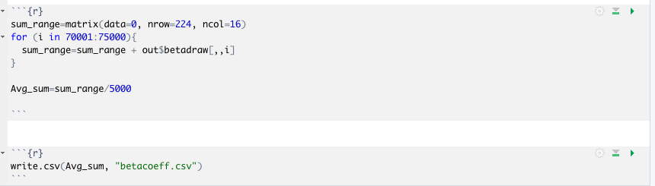
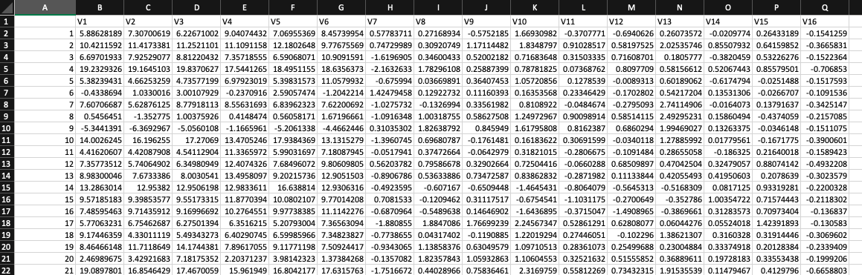

Slide 14

k-Means Cluster Analysis

Slide 15
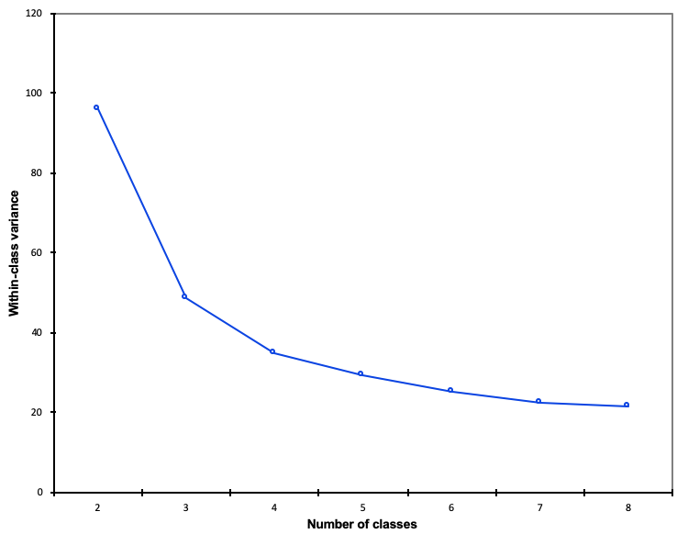
Finding the “Elbow”
Running k-means cluster analysis yields the following graph
We are looking for high variance between clusters and low variance within
The bend or “elbow” in the curve occurs at cluster 4

Slide 16

Market Share Analysis

Slide 17
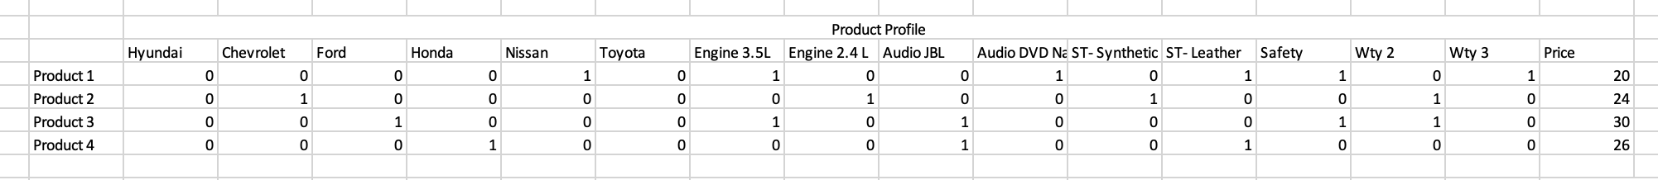
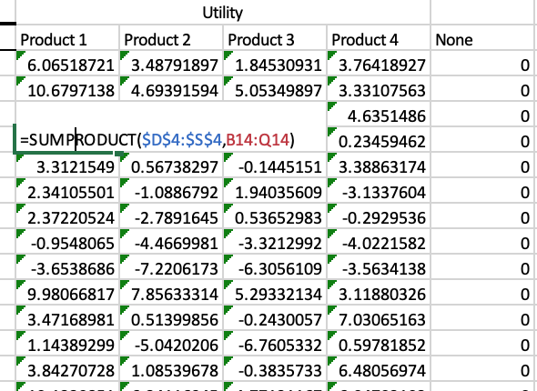
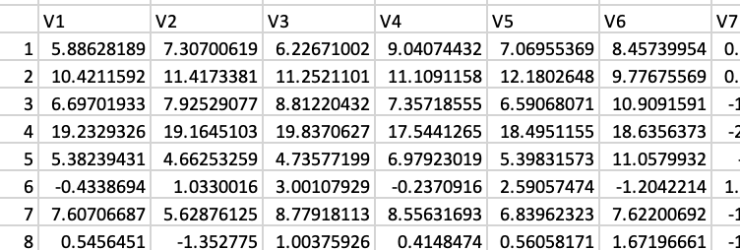

Slide 18
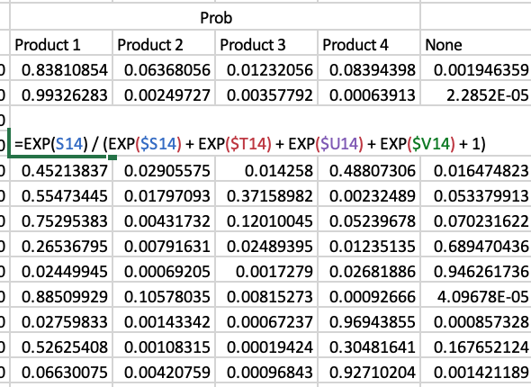
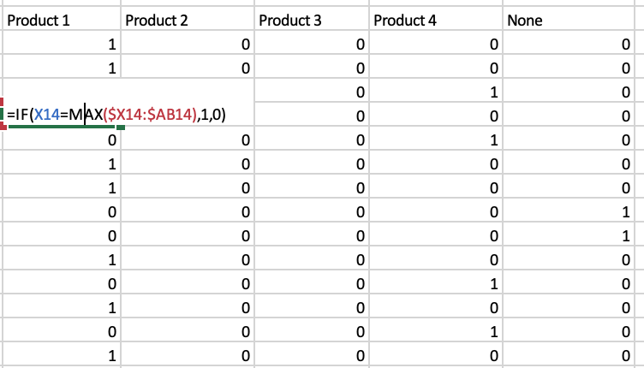

Slide 19
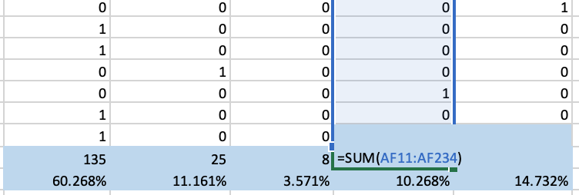
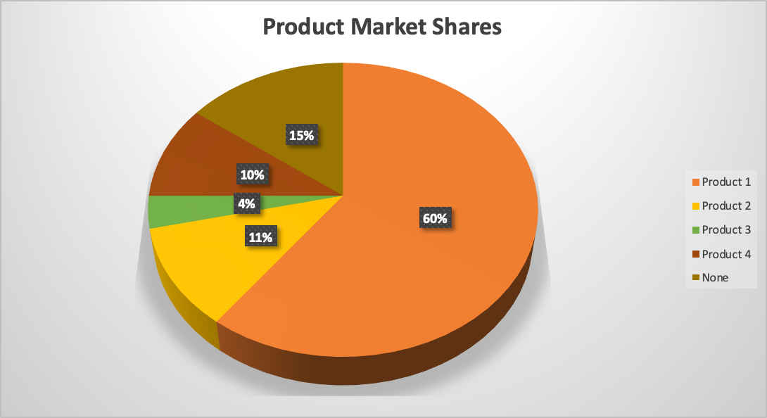

Slide 20
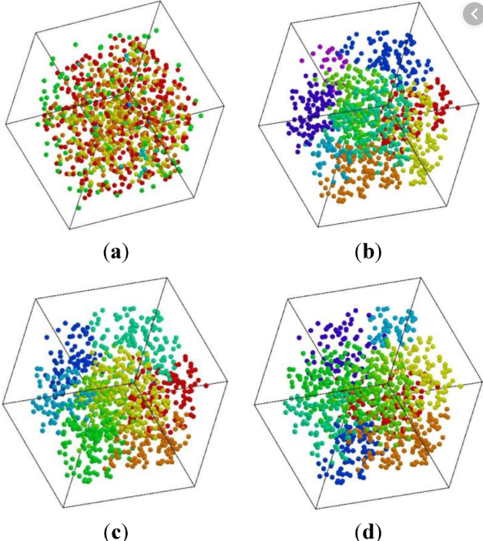
Cluster-wise Relative Importance

Slide 21
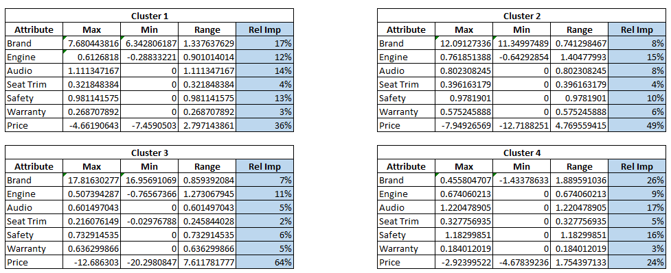
Cluster-wise Relative Importance

Slide 22
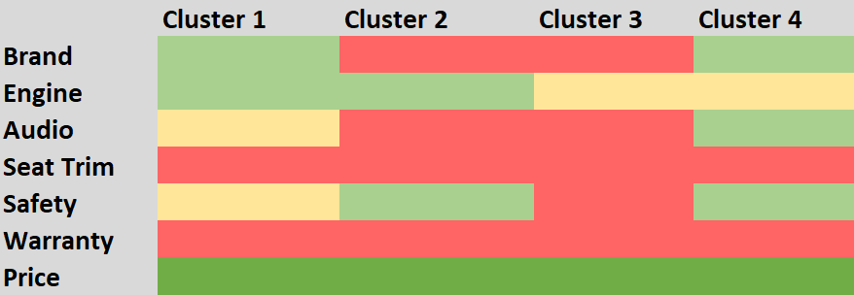
Cluster-wise Relative Importance
Price is the most important attribute across all clusters; Brand, Engine and Safety are the other key factors

Slide 23

Willingness to Pay (WTP)

Slide 24
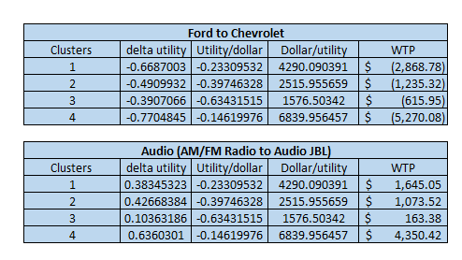
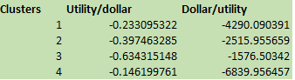
Willingness To Pay

Slide 25
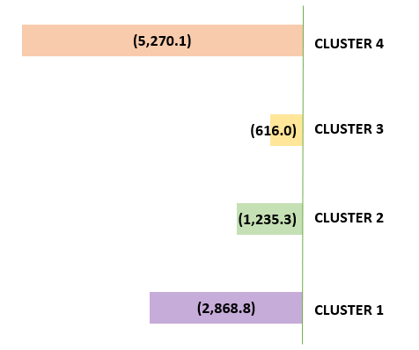


Willingness To Pay
All consumers are willing to pay more for Chevrolet relative to Ford; Cluster 4 has the highest WTP

Slide 26

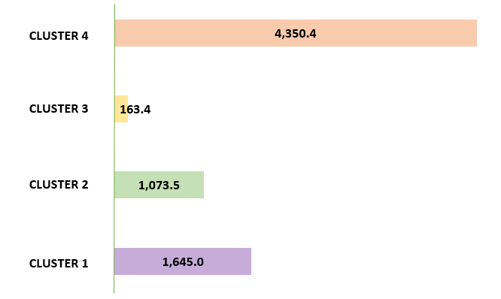

Willingness To Pay
All consumers are willing to pay more for the JBL audio speakers relative to AM/FM Radio; Cluster 4 is willing to pay the highest for JBL audio speakers

Slide 27
Thank You!

